Slide 1

Freelancer Performance & Forecasting Analysis
Tableau Capstone Project | By Abdulrafiu Musa

Slide 2
Project Objectives
Analyze freelancer earnings, success rate, client ratings, and rehire rates
Identify top-performing platforms and experience levels
Forecast future earnings, hourly rates, and success rates using Tableau’s forecasting tool
Provide actionable recommendations to improve freelancer performance and client retention

Slide 3
Data Overview
Two tables – Freelancer Details & Job & Earnings Data
Freelancer Details: Platform, Experience Level, Client Region, Job Category, Payment Method
Job & Earnings Data: Jobs Completed, Earnings USD, Hourly Rate, Success Rate, Client Rating, Rehire Rate
Join Key: Freelancer_ID (Inner Join)

Slide 4

Tools & Methodology
Tool: Tableau for data visualization & forecasting
Data Cleaning: Ensured correct data types
Joined datasets on Freelancer_ID
Created calculated fields for KPIs
Added slicers for Platform, Experience Level, Client Region

Slide 5
Current KPIs (From Dashboard)
• Total Earnings: $9,784,255
• Avg Success Rate: 75.0%
• Avg Client Rating: 4.0 / 5
• Avg Rehire Rate: 44.6%
• Avg Hourly Rate: $52.6

Slide 6
Key Findings
- Success Rate remains steady at ~75%, forecast shows slight dip to 5,964 by Oct 2025
- Earnings projected at $403,691 by Aug 2025
- Hourly Rate expected to stabilize at $4,333 (Monthly average) by Oct 2025
- Intermediate freelancers earn slightly more on average than beginners and experts
- Upwork platform shows highest rehire rate (22.625%) among experts

Slide 7
Key Recommendations
1. Increase Success Rate to at least 78% by targeting low-performing categories with training
2. Raise Avg Hourly Rate by 10% to reach $57.86 in the next 12 months
3. Boost Rehire Rate to 50% by enhancing client communication and post-project engagement
4. Focus on high-earning platforms (Upwork, Toptal) for targeted freelancer onboarding
5. Expand intermediate-level training to sustain higher earning potential

Slide 8
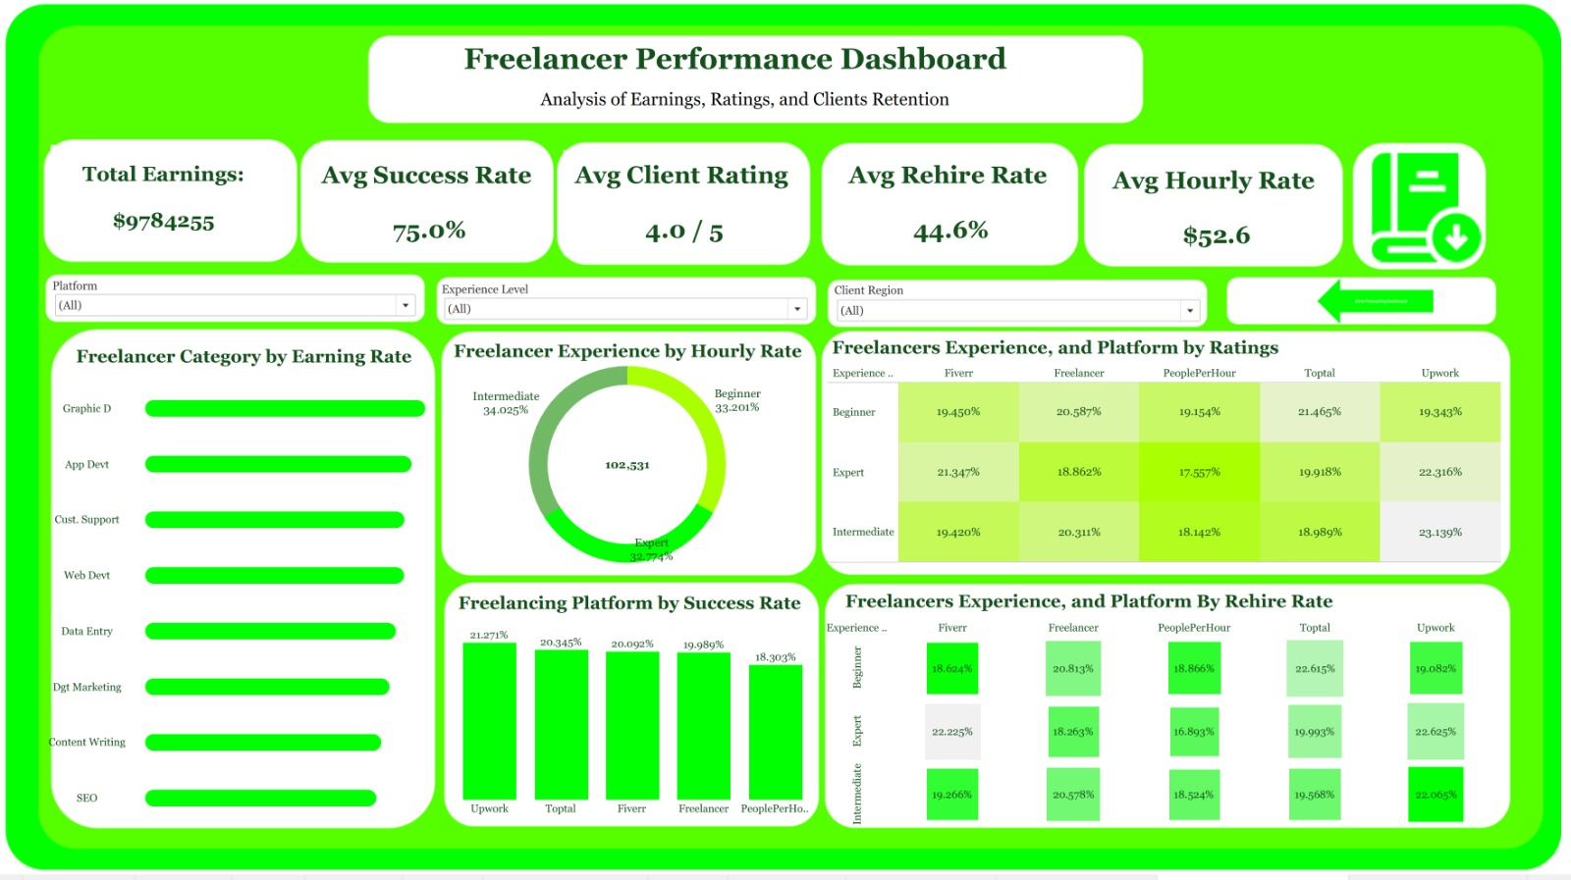
Dashboard Previews

Slide 9
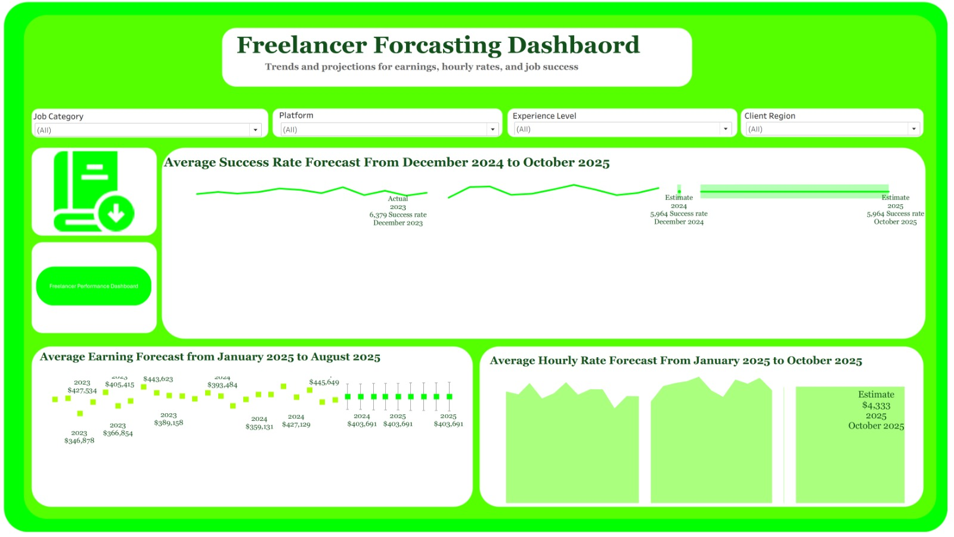
Dashboard Previews

